Slide 1
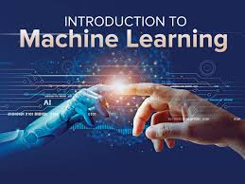
Introduction to Machine Learning

Slide 2
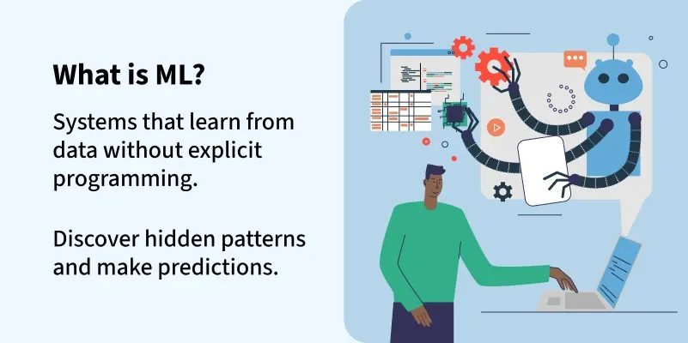
Definition:
Machine Learning (ML) is a branch of Artificial Intelligence that allows computers to learn from data and make predictions or decisions without being explicitly programmed.
But how?
Instead of giving exact rules, we give the machine examples (data) — and it learns the pattern on its own.

Slide 3
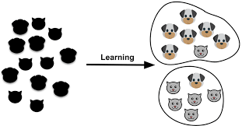
For Example:
If we show the model thousands of pictures of cats and dogs, it learns to identify which is which — even for new images it has never seen before.
Goal:
To make computers automatically improve with experience and handle tasks like prediction, classification, and decision-making.

Slide 4
Why We Need Machine Learning
1. Solves difficult problems
Machine learning can find patterns and answers in situations that are too complex for humans to solve easily.
2. Handles huge amounts of data
It can study and learn from millions of data points much faster than people can.
3. Automates repetitive tasks
It can do the same kind of work over and over again without getting tired or making mistakes.
4. Improves over time
The more data it sees, the smarter it becomes and the better its predictions get.

Slide 5
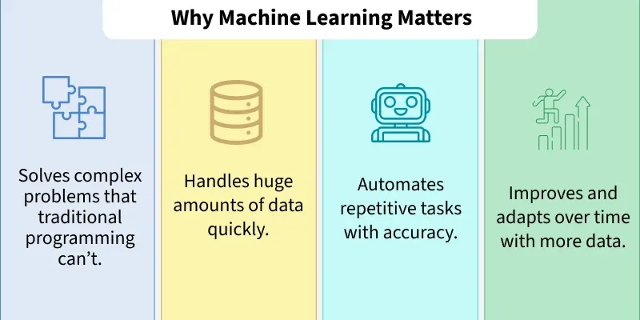

Slide 6
Example:
Imagine you’re teaching a computer how to tell if an email is spam or not.
You give lots of examples of emails — some marked “spam,” some “not spam.”
The computer looks for patterns, like words such as “win,” “offer,” or “free.”
After learning these patterns, it can guess on its own whether a new email is spam or not.
As it sees more emails, it keeps improving its guesses.

Slide 7

Real-World Case Studies: How ML Works in Action
Case Study 1: Paytm – Smarter Fraud Detection
Paytm handles millions of payments daily — far too many for humans to check.
So, it uses ML models trained on past transactions to spot fraud patterns.
When you make a payment, the model instantly checks:
Is the amount unusually high?
Is it from a new device or location?
Has this receiver been flagged before?
If anything seems suspicious, it blocks the payment immediately.
Each new case helps the model learn and improve over time.

Slide 8
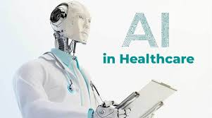
Case Study 2: Healthcare – Predicting Diseases Early
Hospitals get thousands of patient reports daily — too much for doctors to analyze one by one.
ML models trained on past data (symptoms, test results, outcomes) help identify risks early.
When a new report arrives, the model looks for:
Patterns similar to past heart or diabetes cases
Unusual test values
If it detects risk, it alerts doctors for faster diagnosis and treatment.
Result: quicker decisions, better care, and continuous learning with every patient.

Slide 9
Why Machine Learning Is Becoming a Big Part of Our Daily Lives
Data Growth – Every photo, message, or click adds to the huge pool of data that helps ML models learn better.
Computing Power – With faster and cheaper computers and cloud systems, ML can now handle complex tasks easily.
Internet Usage – The more we go online, the more data we generate — and ML learns from it all.
Automation Needs – Businesses want machines to handle routine work, so ML steps in to make things faster and more efficient.
Personalization – People love getting customized suggestions — from shopping to movies — and ML makes that happen.
Smart Devices (IoT) – Our phones, cars, and home gadgets keep sending real-time data that ML uses to make smarter systems.
Smarter Algorithms – New techniques like deep learning help machines do things once thought impossible, like recognizing faces or understanding speech.

Slide 10
Types of machine learning:
Let’s take one example to make everything easy to relate:
Example: Imagine you’re teaching a computer to recognize fruits (apples, bananas, and oranges).
1. Supervised Learning
Idea: The computer learns with the help of labeled data — means you already know the right answers.
Example:
You give the model hundreds of fruit images, each labeled — “this is an apple,” “this is a banana,” etc.
The model learns the relationship between the image features (like color, shape, size) and the labels.

Slide 11
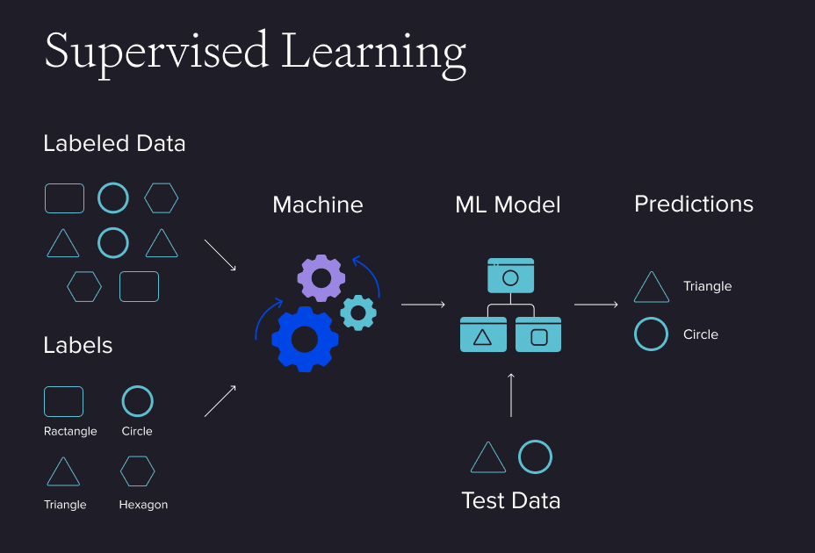
When used:
When we have past data with known outcomes.
For prediction or classification tasks.
Real-life examples:
Email spam detection, price prediction, disease diagnosis.

Slide 12
2. Unsupervised Learning
Idea: The computer learns without labels — it tries to find patterns or groups on its own.
Example:
Now, you give the model a bunch of fruit images, but don’t tell which is which.
It observes the data and groups similar fruits together — apples with apples, bananas with bananas — based only on their features.
When used:
When data has no predefined labels.
For finding structure or hidden patterns.
Real-life examples:
Customer segmentation, market basket analysis, grouping similar songs or movies.

Slide 13
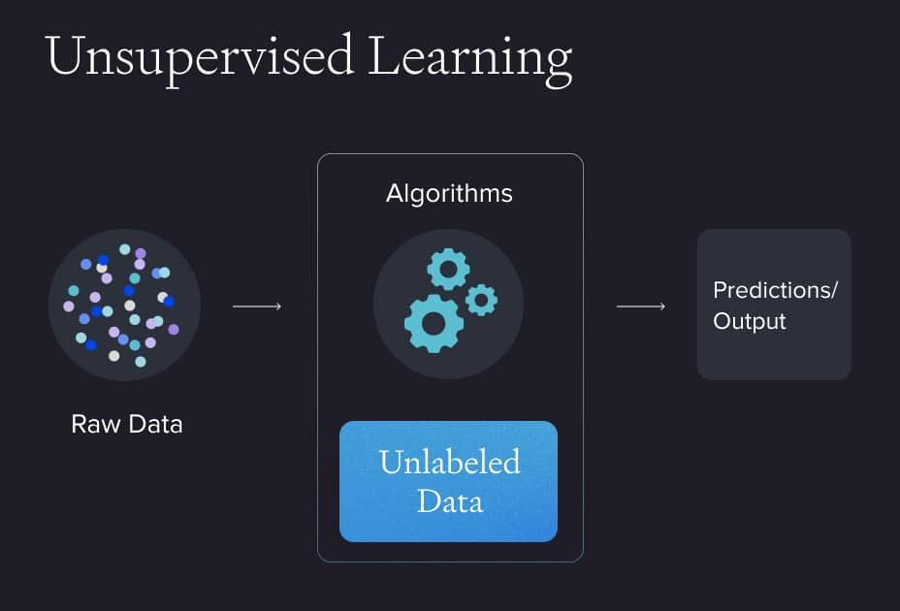

Slide 14
3. Semi-Supervised Learning
Idea: A mix of both — some data is labeled, most is not. The model uses the few labeled examples to help classify the rest.
Example:
You label only 50 fruit images (apple, banana, orange) but have 1000 total images.
The model learns from those few labeled examples and guesses the rest by finding similarities.

Slide 15
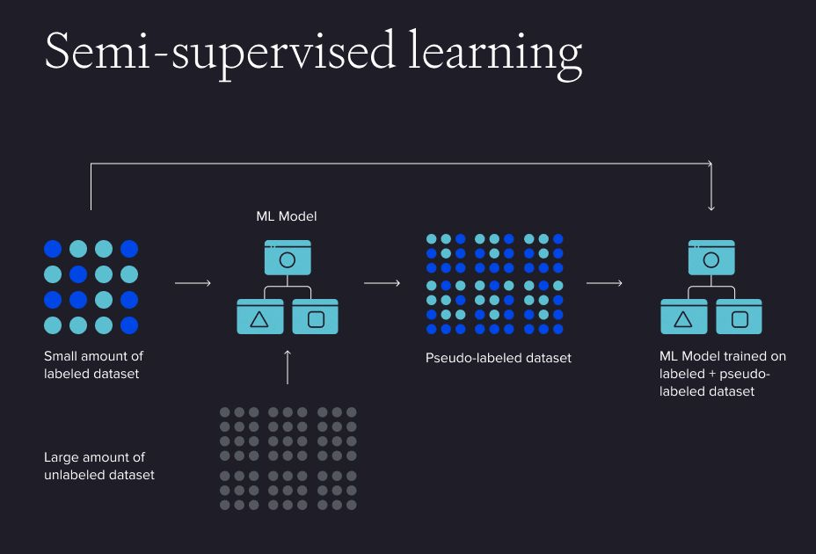
When used:
When labeling all data is costly or time-consuming.
Real-life examples:
Speech recognition, web content classification, medical imaging.

Slide 16
4. Reinforcement Learning
Idea: The computer learns by trial and error, getting rewards or penalties for its actions — just like humans learn from experience.
Example:
You have a robot trying to pick the right fruit from a basket.
If it picks an apple correctly → reward.
If it picks the wrong one → penalty.
Over time, it learns the best way to act for maximum reward.

Slide 17
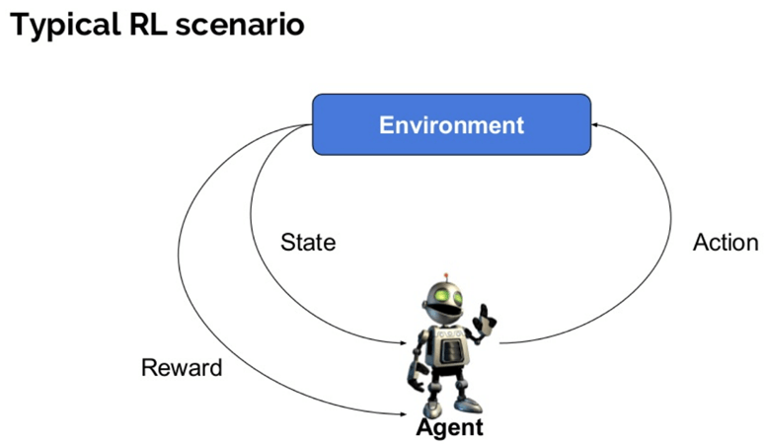
When used:
When the goal is to make a sequence of decisions based on feedback.
Real-life examples:
Self-driving cars, game-playing AI, robots, recommendation systems.

Slide 18
Applications of Machine Learning
1. Automatic Language Translation
Apps like Google Translate use ML to understand and convert text or speech from one language to another, helping people communicate easily across languages.
2. Medical Diagnosis
ML analyzes medical images and patient data to help doctors detect diseases like cancer or diabetes early and more accurately.
3. Stock Market Trading
ML studies past stock data and market trends to predict price changes and help traders make faster, data-driven decisions.
4. Online Food Delivery
Apps like Swiggy or Zomato use ML to predict delivery times and suggest restaurants or dishes you might like.

Slide 19
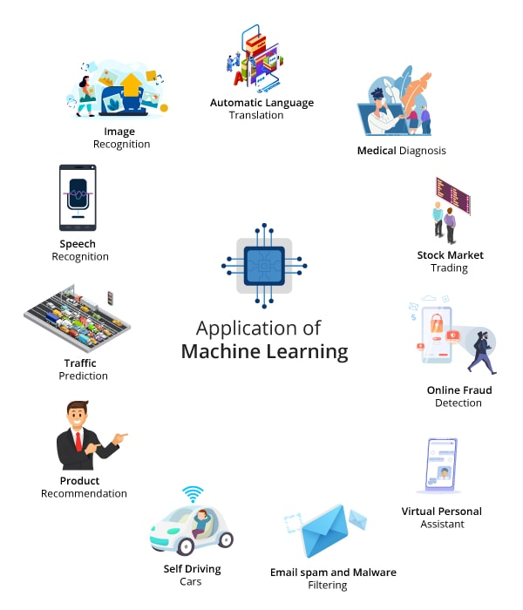

Slide 20
5. Virtual Assistants
Siri and Alexa use ML to understand your voice commands and perform tasks like calling, texting, or playing music.
6. Email Spam Detection
ML automatically filters out spam by learning what kinds of messages are unwanted or unsafe.
7. Self-Driving Cars
ML helps cars recognize roads, traffic, and obstacles, allowing them to drive safely without human control.
8. Product Recommendation
Amazon and Netflix use ML to suggest products or shows based on what you’ve liked before.
9. Traffic Prediction
Google Maps uses ML to analyze real-time traffic data and suggest the quickest routes.
10. Speech Recognition
ML turns spoken words into text, making voice typing and commands possible.
11. Image Recognition
ML identifies faces, objects, or animals in pictures — used in security, healthcare, and social media.

